Slide 1
NESTED CLASSES
COM2044-B OOP

Slide 2
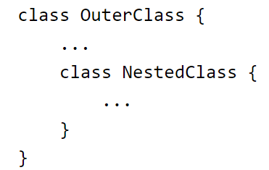
NESTED CLASSES
The Java programming language allows us to define a class within another class. Such a class is called a nested class and is illustrated as the following:

Slide 3
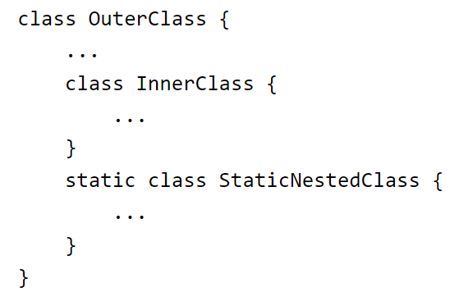
NESTED CLASSES
Nested classes are divided into two categories:
Non-static
Static
Non-static nested classes are called inner classes.
Nested classes that are declared static are called static nested classes.

Slide 4
NESTED CLASSES
A nested class is a member of its enclosing class.
Non-static nested classes (inner classes) have access to other members of the enclosing class
even if they are declared private
Static nested classes do not have access to other members of the enclosing class.
As a member of the OuterClass, a nested class can be declared private, public, protected, or package private.
Recall that outer classes can only be declared public or package private.

Slide 5
NESTED CLASSES
Why Are Nested Classes Used?
It is a way of logically grouping classes that are only used in one place
If a class is useful to only one other class, then it is logical to embed it in that class and keep the two together. → Helper Classes
It increases encapsulation
Consider two top-level classes, A and B
where B needs access to members of A that would otherwise be declared private
By hiding class B within class A, A's members can be declared private and B can access them
In addition, B itself can be hidden from the outside world
It can lead to more readable and maintainable code
Nesting small classes within top-level classes places the code closer to where it is used

Slide 6
INNER CLASSES
An inner class is associated with an instance of its enclosing class and has direct access to that object's methods and fields
Since an inner class is associated with an instance, it cannot define any static members itself
Objects that are instances of an inner class exist within an instance of the outer class

Slide 7
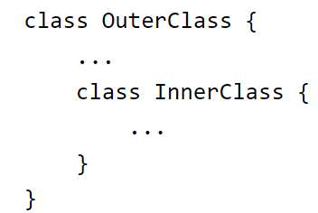
INNER CLASSES
Consider the following classes:
An instance of InnerClass can exist only within an instance of OuterClass and has direct access to the methods and fields of its enclosing instance
To instantiate an inner class, you must first instantiate the outer class
Then, create the inner object within the outer object with this syntax:

Slide 8
STATIC NESTED CLASSES
As with class methods and variables, a static nested class is associated with its outer class
Like static class methods, a static nested class cannot refer directly to instance variables or methods defined in its enclosing class
It can use them only through an object reference
A static nested class interacts with the instance members of its outer class (and other classes) just like any other top-level class
In effect, a static nested class is behaviourally a top-level class that has been nested in another top-level class for packaging convenience
A static nested class is instantiated the same way as a top-level class:

Slide 9
Inner Class and Nested Static Class Example
Our example, OuterClass, along with TopLevelClass, demonstrates which class members of OuterClass an inner class (InnerClass), a nested static class (StaticNestedClass), and a top-level class (TopLevelClass) can access.

Slide 10
SHADOWING
If a declaration of a type (such as a member variable or a parameter name) in a particular scope (such as an inner class or a method definition) has the same name as another declaration in the enclosing scope,
then the declaration shadows the declaration of the enclosing scope. You cannot refer to a shadowed declaration by its name alone.

